Slide 1
Lecture 25: Professional Ethics in the light of Right Understanding

Slide 2


Slide 3
Placement of Module 5
Understanding Harmony
Modules 1-4
Feeling of relationship
mutual fulfilment, values
Thought Principles and
Guidelines for
Ethical Human Conduct
Module 5
Behaviour Ethical behaviour
Work and Ethical work (examples and
Participation Ethical participation case studies…)
Outcome Continuous happiness at individual level and
expected Fulfilment of human goal at societal level

Slide 4
Recap
In the previous lecture, we saw how right understanding provides the basis for ethical human conduct.
Now, in this lecture, we shall try to understand that it is this ethical competence only which is instrumental in ensuring professional ethics as well.

Slide 5
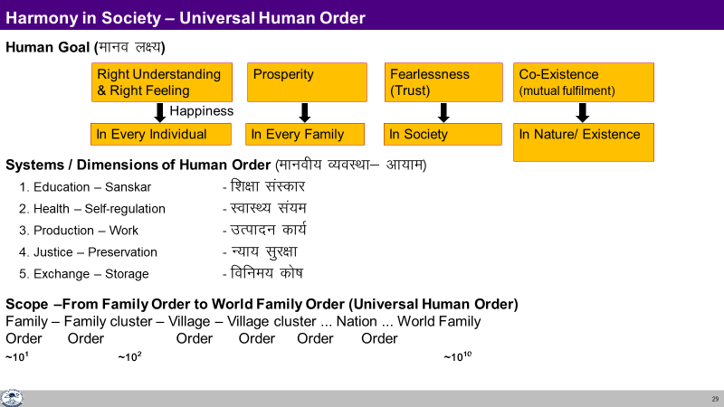
Profession – In Context of the Comprehensive Human Goal
A profession is a mode of participation by human beings in the larger order in pursuance of comprehensive human goal-individual & collective.
The excellence or the success of any professional activity is to be judged from this comprehensive point of view only and not in terms of merely wealth generation.
The profession is not only a means of earning one’s livelihood, but also a means of one’s evolution by appropriate participation in the larger order.
It is an important activity to authenticate one’s understanding, whereby we interact with other human beings and with rest of nature in a mutually fulfilling manner.

Slide 6
Professional Ethics
Professional ethics can be seen as the code of ethical conduct of the profession (as defined above).
Ethical conduct of profession implies the right utilization of one’s professional skills for participation in the larger order towards the fulfillment of comprehensive human goal.

Slide 7
Salient Features Characterizing Professional Ethics
Clarity about the comprehensive human goal
Confidence in oneself as well as confidence in the harmony, coexistence and self-regulation prevailing in entire existence
Competence of mutually fulfilling behaviour
Competence of mutually enriching interaction with nature
Holistic vision about technologies, production systems and management techniques.
Understanding of one’s societal responsibility

Slide 8
Issues in Professional Ethics – The Current Scenario
The issues in professional ethics are becoming very complex in the current scenario.
The unethical practices are rapidly increasing and their impact is also becoming far-reaching.
As a result of this ‘epidemic’ of unethical practices, we are frequently coming across serious scams, major economic offences, kickbacks in large scale purchases etc.

Slide 9
Some Salient Categories of Unethical Practices Today
Corruption in multiple forms and at various levels
Tax evasion, misappropriation and misuse of public funds
Misuse of political power and bureaucratic authority
Misleading propaganda, unethical advertisements and sales promotion
Cut-throat competition
Exploiting the weakness of consumers through various enticements, bewildering advertisements
Adulteration and spurious production
Endangering the health and safety of public at large
Hoarding and over-charging etc.
The list could be much longer…

Slide 10
Prevailing Approaches towards Promotion of Professional Ethics
Promoting awareness about professional ethics by introducing new courses, refresher programs and case studies
Administering oaths and prescribing codes of ethical conduct for specific professional disciplines
Setting up mechanisms for intensive audit inspection and monitoring the activities
Framing more stringent laws and devising harder punishments for offences Promoting transparency in working systems through mechanisms like RTI (Right to Information Act), etc.
Carrying out ‘sting operations’ and widely publicising serious lapses in ethical conduct of profession through media
Encouraging whistle blowing by individuals or groups
Setting up Lokpals, vigilance commissions, ethics committees, tribunals, consumer protection forums, etc.
Filing public interest litigations (PIL), etc.

Slide 11
Inadequacy of Prevailing Approaches
Looking at the various methods and mechanisms which are being presently employed to check these trends and their effectiveness, one can see that most of the methods being adopted are either of symptomatic nature or punitive measures or crisis management techniques rather than real solutions to the whole problem.
The focus in these methods is primarily towards curbing the ill effects rather than rectifying the root cause, namely the faulty world-view which continues to remain dominant (managing the disease rather than ensuring health).

Slide 12
Inherent Contradictions and Dilemmas
We can understand more clearly through examples how the contradictions and dilemmas are inherently generated by the prevailing worldview in which wealth maximization is perceived to be the prime objective.
Thus, the other person’s happiness (assumed to be related to wealth accumulation) seems to be in conflict with my happiness.
In that case, the other people have to be exploited for one to gain affluence and there is no possibility of mutual fulfillment in a sustainable way.
In the same way, exploitation of nature also becomes inevitable as it helps a person to accumulate wealth easily and there is no limit to this.
Take the example of business circles, whenever there is a scarcity of commodity due to say – monsoon failure or other natural disturbances or wars etc., the people in general are in distress and need support. However, in such a situation, the businessmen endowed with prevailing (inhuman) world view will feel elated and look at it as an opportunity to make maximum profit.

Slide 13
Different Approaches to Ethics and Professional Ethics
 | Prevalent (Prescriptive) | Proposed (Humane)
Basis | Assumptions (thought) | Right Understanding of co-existence, harmony and relationship
Feeling | Opposition | Relationship
Values | Assumed values – based on assumptions and opposition | Naturally acceptable values, Wellbeing of all
Ethics: How to interact with the world outside | Mostly prescriptive, in the form of do’s and don’ts | Details based on right Understanding (as described)- verifiable by everyone thru NA Basic agreements for order in society
Way of ensuring in society | Training, Discipline Incentives and punishment | Human Education, Self-discipline Self-motivation

Slide 14
The Way Ahead
To resolve the situation, sincere effort towards building up the ethical competence of human beings in general and professionals in particular through human education [starting with value education and value based education leading to value-based living]
It can be an effective way to safeguard professional ethics.

Slide 15
Key Takeaways
Clarity of comprehensive human goal and our participation in different dimensions of society will ensure Ethics in profession.
This also clarifies the lacunae in the present approaches.

Slide 16
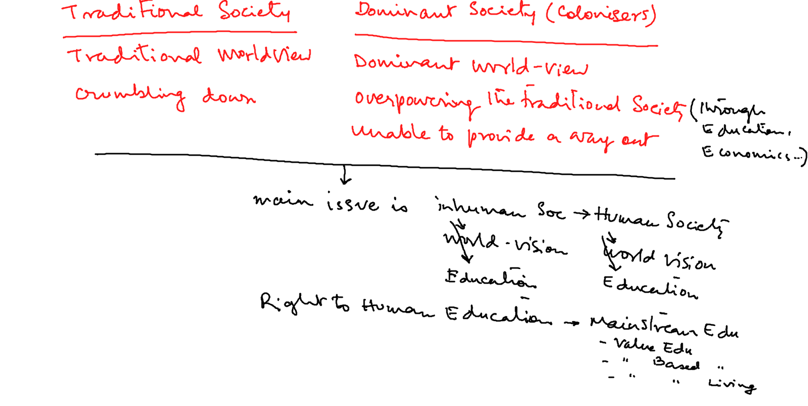
The question is not traditional vs modern society – the question is inhuman society to human society.
We understand human society – then with that yardstick, we can evaluate both the modern society as well as the traditional society (ies) and draw up the steps to transition to the desired state
And we have to start with ourselves first… work for human education…

Slide 17
  Values- Feelings (Naturally Acceptable) of human being
  Morality- Thoughts of how to live with these values in relation to world outside
  Ethics- Guidelines about expression in living- i.e. In behaviour, work & participation in the larger order
  Ethical Conduct- Living (behaviour, work & participation in the larger order) based on human values
  Profession- A mode of participation by human beings in the larger order in pursuance of comprehensive human goal- individual & collective.
  Professional Ethics- the code for ensuring right utilization of one’s professional skills for participation in the larger order towards the fulfillment of comprehensive human goal.

Slide 18
  Values- Feelings (Naturally Acceptable) of human being
  Policy- Detailed thought of how to live with human values- plan, program, implementation, result, evaluation and updation.
  Character- compassionate behaviour, work & participation in the larger order
  Personality- expression of human being with the world outside- in terms of behaviour, work & participation in the larger order

Slide 19
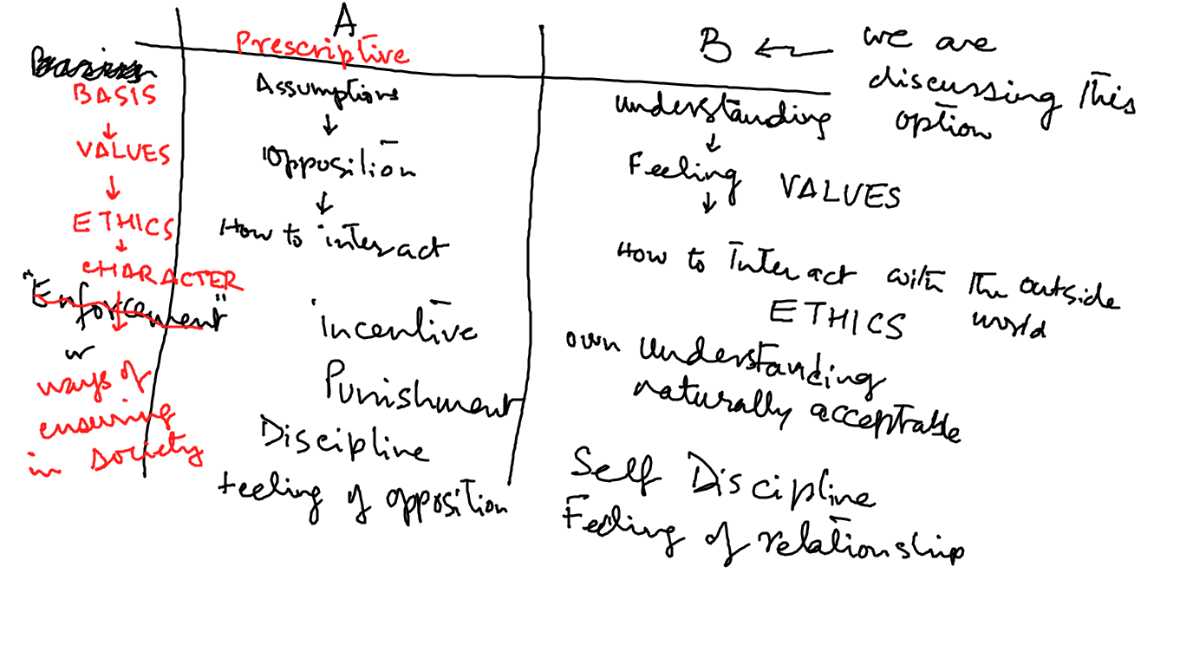

Slide 20
